Slide 1


Training, Accreditation & Certification Requirements and Training Guide
Understanding and Navigating Partner Program Training and Compliance

Slide 2
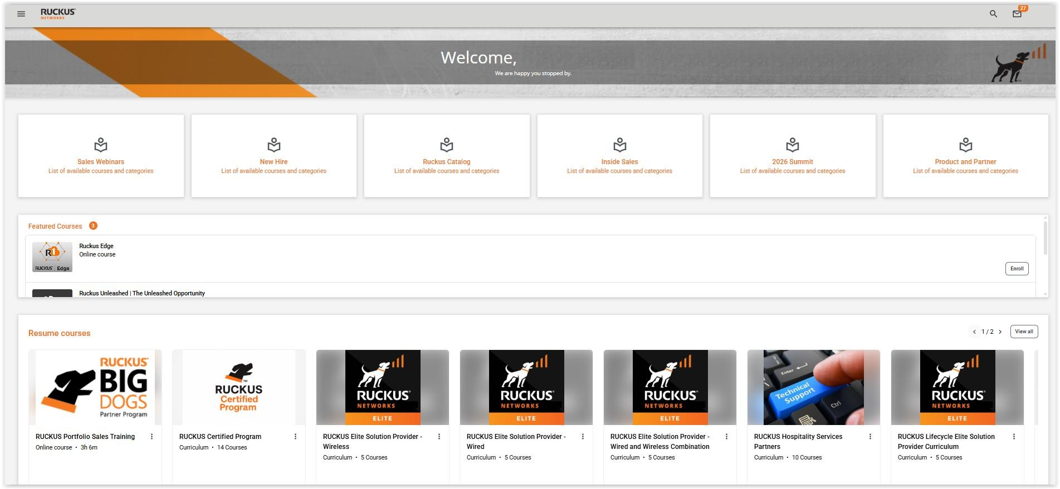
RUCKUS® Education Services provides gold standard technical content that is recognized by networking professionals around the world.
As a valued Partner, we offer best-in-class training ensuring that you can add real value to your customers.
Participation in the RUCKUS BIG DOGS Partner Program requires that you meet certain standards. This presentation will walk you through the necessary
testing requirements and
associated courseware.

Slide 3
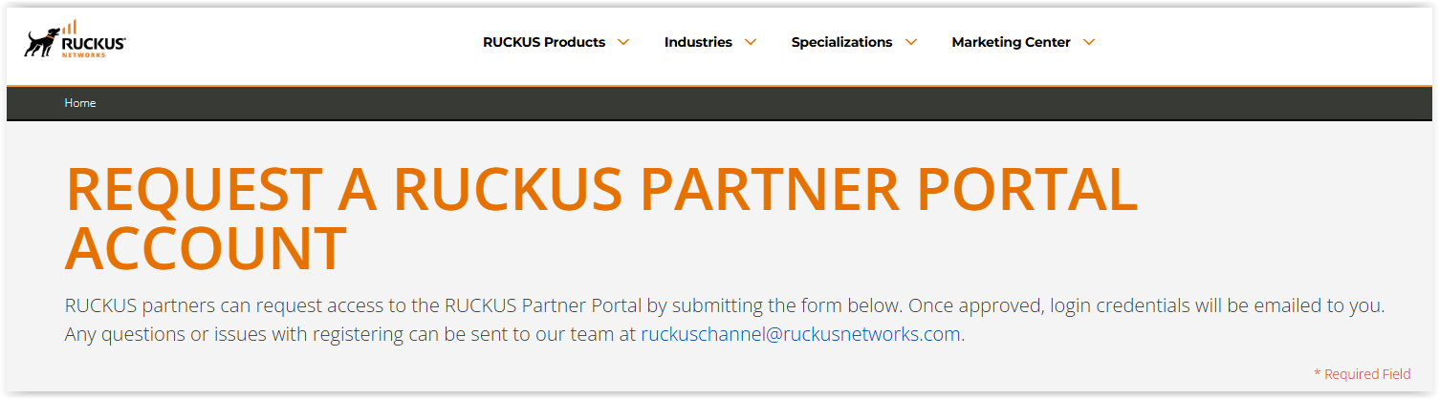


Accessing RUCKUS Partner Training—Step 1
Step 1:
Ensure you have a RUCKUS Partner Portal account
If you do not already have a RUCKUS Partner Portal account, create one here. You must be a registered RUCKUS Partner to create an account.
– Not a RUCKUS Partner yet? Join here today.
Accounts are activated within 24 hours, and you will receive your login credentials from
ruckuschannel@ruckusnetworks.com.
Your login credentials will be in the form of firstname.lastname@rwbigdog.com. This is not an e-mail
address. This is simply your username for the RUCKUS Partner Portal.
If you do not receive your credentials within 24 hours, check your spam folder. Contact ruckuschannel@ruckusnetworks.com for further assistance.
*IMPORTANT: Ensure your most up-to-date company e-mail address is associated to your rwbigdog account.
If you need assistance updating your company e-mail on your profile, contact ruckuschannel@ruckusnetworks.com.

Slide 4
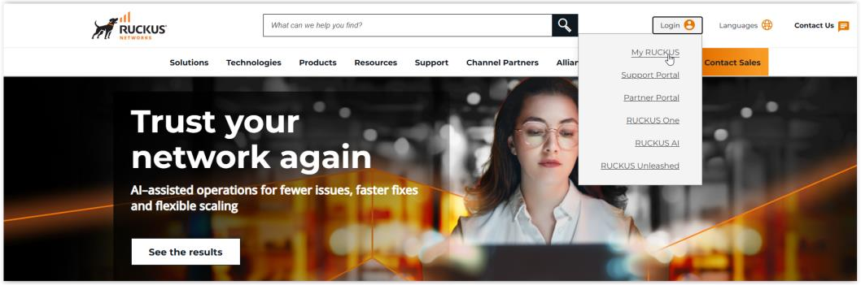
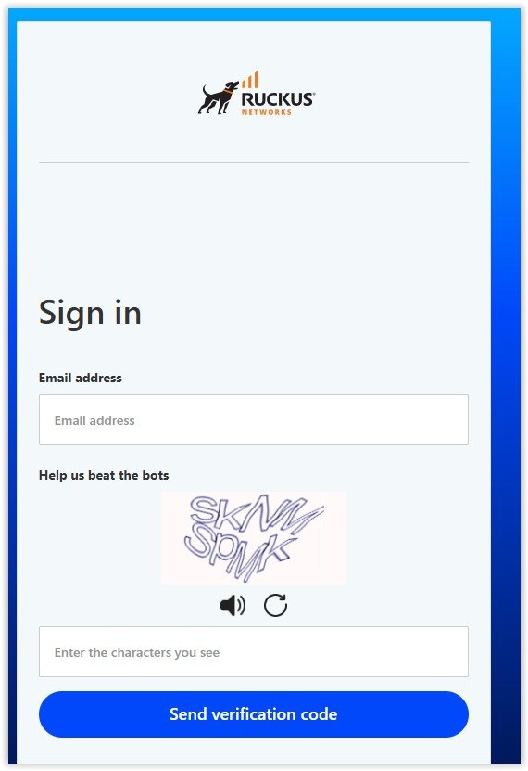
Accessing RUCKUS Partner Training—Step 2
Step 2:
Ensure you have a RUCKUS Networks
University account
All RUCKUS BIG DOGS Partner Program training is located in RUCKUS Networks University. To access and complete RUCKUS Partner training, you must have a RUCKUS Networks University account in addition to your RUCKUS Partner Portal account. These are two separate portals with separate logins.
See instructions below on how to create a MyRUCKUS account if you do not already have one:
Access RUCKUS Training and Certifications section on ruckusnetworks.com
Select “Login to RUCKUS Networks University” (at the bottom of the page) to create your account.
Or, complete the new user registration here – click on “Sign Up” to enter your e-mail and receive a verification code to proceed.
Please also view the “Learn how to create an account” video. This walks you through how to set up your MyRUCKUS account.
*IMPORTANT: You must register using your company e-mail (your rwbigdog username is used for the RUCKUS Partner Portal login only and cannot be used for accessing RUCKUS training in RUCKUS Networks University). Your RUCKUS Networks University username should be your company e-mail address. Do not register using a personal e-mail address as this will inhibit your training and certifications from being properly tied to your RUCKUS Partner Portal account record.

Slide 5
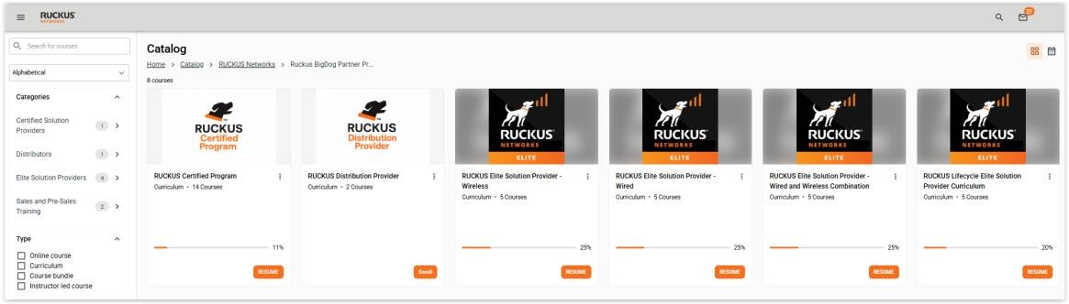
Accessing RUCKUS Partner Training—Step 3
Step 3:
Access and complete RUCKUS Partner
training
Once the prior steps are complete, we recommend waiting ~15 minutes before logging in to access RUCKUS training within RUCKUS Networks University.
This will ensure your profile is assigned the proper “Partner” permissions based on your company e-mail domain. Again, if you register
using a personal e-mail address, your profile will not be tagged as a Partner account and you will not be able to access the RUCKUS partner training.
How to find and access RUCKUS partner training:
You can navigate to all RUCKUS Partner training curriculums directly from the RUCKUS Partner Portal training page.
You can navigate to all RUCKUS Partner training within RUCKUS Networks University via Catalog → Product Training → RUCKUS Networking → RUCKUS BIG DOGS Partner Program. Or directly here.
Choose the curriculum suited to your desired partner level and enroll to view/complete courseware and associated exams.
*If you are a RUCKUS Partner and receive an error message when trying to access any of the training course links, please reach out to TrainingSupport@ruckusnetworks.com to ensure your account has been correctly set up with partner permissions.

Slide 6
Accessing RUCKUS Partner Training—Summary
In order to access and complete RUCKUS BIG DOGS Partner Program training,
accreditations and certifications, you need two accounts:
1. RUCKUS Partner Portal Account
2. RUCKUS Networks University Account
Username: fistname.lastname@rwbigdog.com
Account information must reflect your current company e-mail address.
The RUCKUS Partner Portal contains
direct links to all Partner Program training. Links lead directly to RUCKUS Networks University curriculums.
In order to access this training, you must also have a RUCKUS Networks University account.
Username: your current company e-mail address
Do not use a personal e-mail address to complete training. It will not tie back to your partner record in the RUCKUS portal.
All RUCKUS partner training is accessed and completed within RUCKUS Networks University and tied back to the RUCKUS Partner Portal account due to the company e-mail match between the two accounts.
Training completed in a given week will be reflected on your RUCKUS Partner Portal account the following Tuesday.

Slide 7
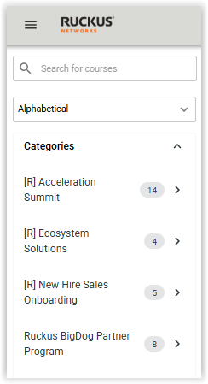
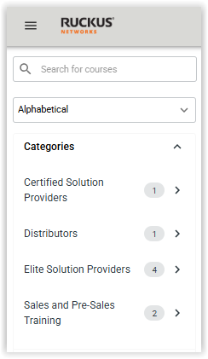

For ease of access, curriculums are provided focusing on Partner level
Select the new RUCKUS BIG DOGS Partner Program folder from the catalog and then the appropriate Partner level to view required training materials
Open the curriculum and click “Enroll” to view the classes to launch (you must also “Enroll” in each individual class)
Courses and exams are also available individually by searching the catalog

Slide 8
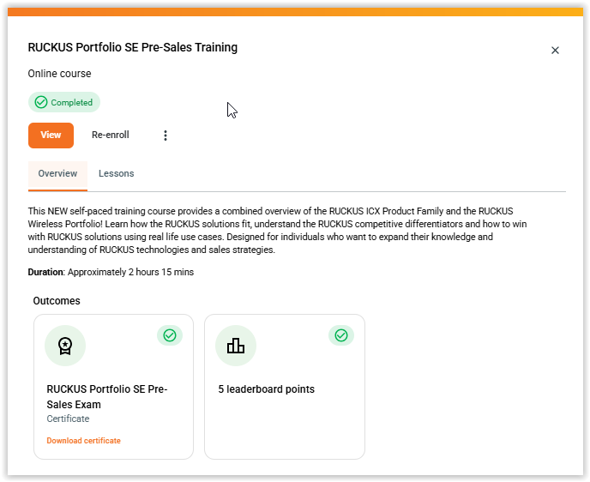



Accessing your certificates
When a class or accreditation is completed, the status indicator on the right side of the course page will display the accompanying certificate of completion.
Click the Certificate link to view and download it.
Certain Accreditation exams and courses DO NOT show certificates here as they are managed separately.
You’ll receive an email with instructions on how to access these certificates and digital badges upon completion of these exams (i.e. RICXI Accreditation Exam, RASZA Accreditation Exam, etc.).
You can also locate your certificates under “My Training Record”

Slide 9
RUCKUS BIG DOGS Partner Program—Core Training Requirements

Slide 10

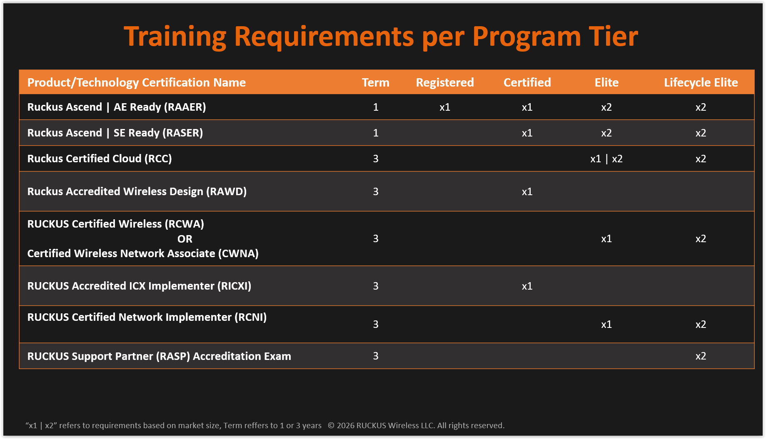
RUCKUS Partner Training Requirements
Elite RUCKUS Partners must achieve and maintain select training and accreditations and/or certifications.
Accreditations—Open- book, no fee, online exams available on RUCKUS Networks University.
Certifications—Proctored, fee-based, on-line exams available from 3rd party.
The table to the right outlines the mandatory exams and accreditations to meet Partner Training requirements.
All Sales & Pre-Sales are valid for one year from date of completion. Technical accreditations and certifications are valid for three years from date of completion.

Slide 11
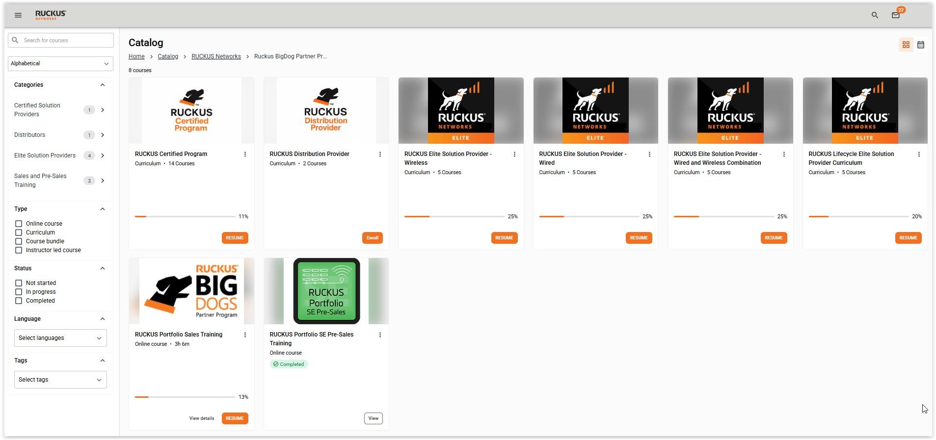
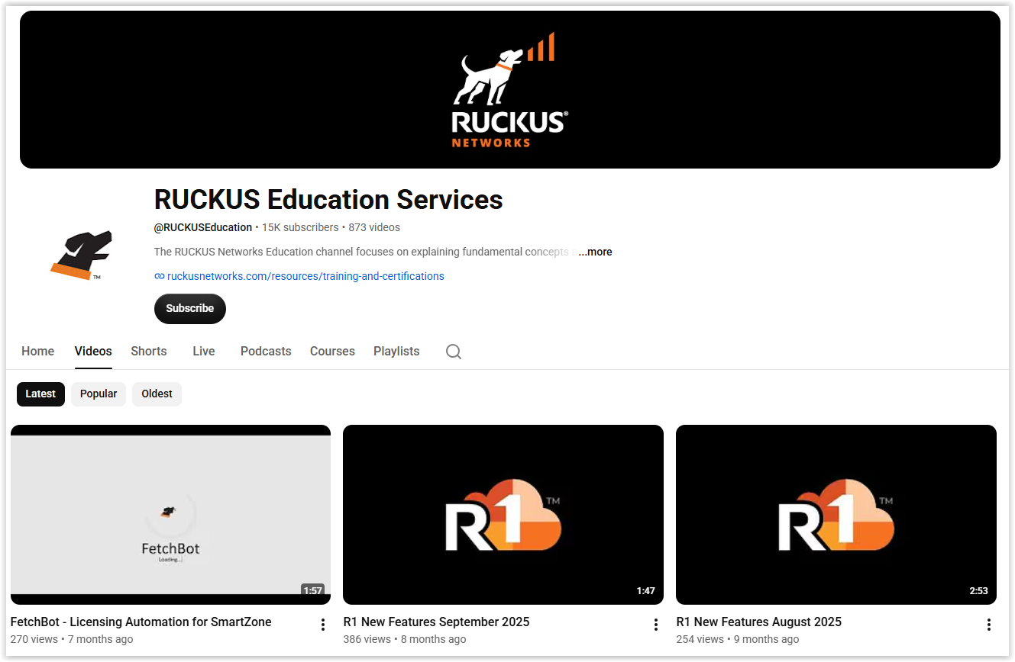
RUCKUS Education Services provides additional technical content aimed at increasing your WiFi and Wired networking expertise. Be sure to browse our catalog on RUCKUS Networks University and as a partner, all on-line training is free to you.
Also, be sure to check out our RUCKUS Education YouTube channel for more technical training, our podcast—RUCKCAST and Livestreams.
For questions or more information regarding RUCKUS Education Services, please contact Trainingsupport@ruckusnetworks.com

Slide 12
Viewing Partner Compliance in the RUCKUS Partner Portal

Slide 13

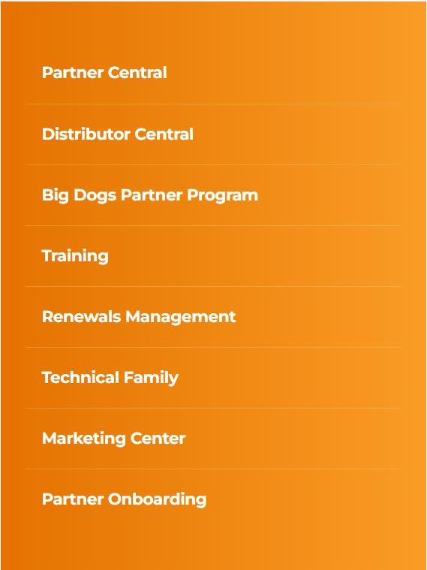
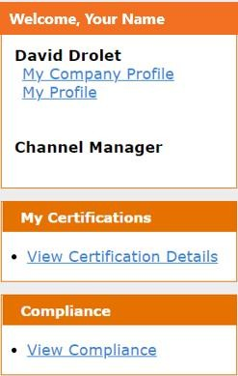
View Compliance (Partner)
Your Name
Log in to the Partner Portal
Click on “Partner Central”
At the Home Tab, click the “View Compliance” link on the left-hand side
Compliance table window will appear to show your current training counts vs. what’s required
* For questions regarding partner program training or compliance, please contact your Account Manager. For additional support, you can also reach out to Trainingsupport@ruckusnetworks.com or RuckusChannel@ruckusnetworks.com.

Slide 14
Thank you!
14
© 2026 Ruckus Wireless LLC. All rights reserved.
PT-116140.15 (06/26)

